Slide 1





Exploring how groundwater buffers the influence of heatwaves on vegetation function during multi-year droughts?
Mengyuan Mu, Martin De Kauwe, Anna Ukkola, Andy Pitman,
Weidong Guo, Sanaa Hobeichi, and Peter Briggs

Slide 2
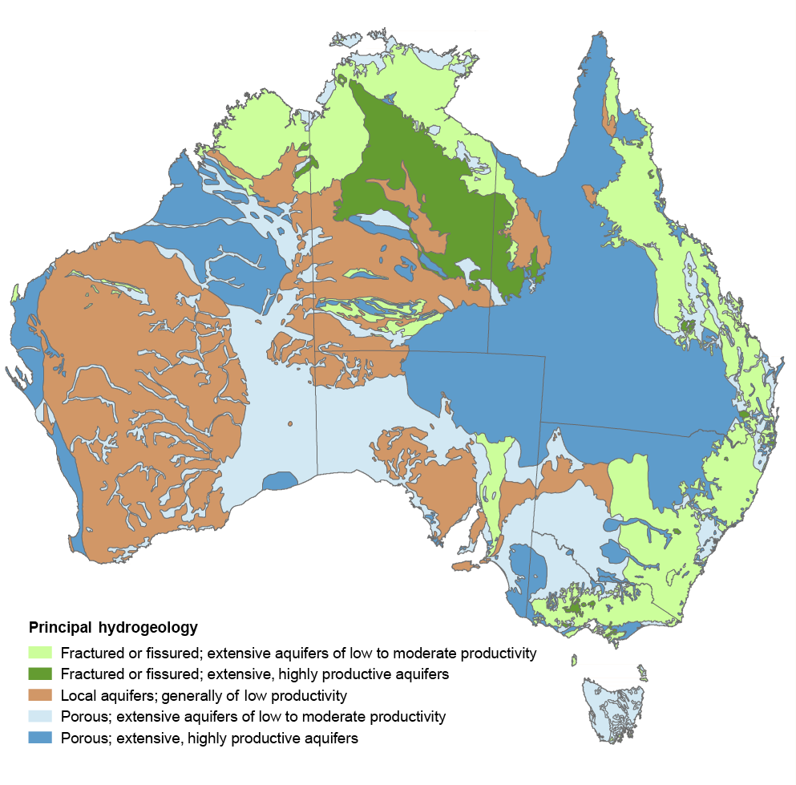
Groundwater & groundwater dependent ecosystem (GDE)
Groundwater aquifer in Australia
Groundwater supports over 30% of total water consumption
Dark blue and green are most productive aquifers

Slide 3
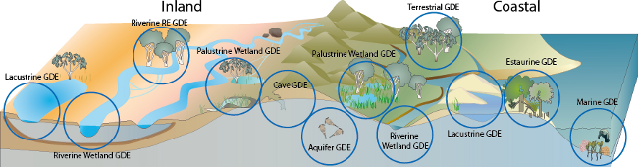
Groundwater & groundwater dependent ecosystem (GDE)
Groundwater aquifer in Australia
Groundwater supports over 30% of total water consumption
34% of Australia’s landscape contains GDEs and 5% of them heavily rely on groundwater
As drought occurs, the usage of groundwater increases for both human and terrestrial ecosystem
Dark blue and green are most productive aquifers
Australian GDEs

Slide 4
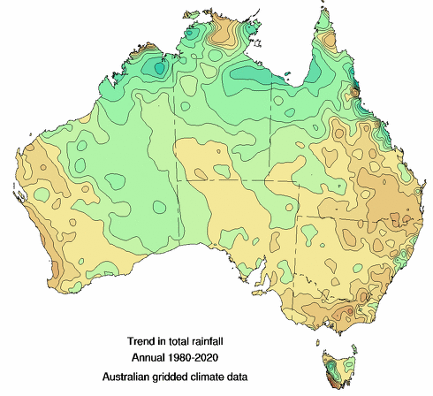
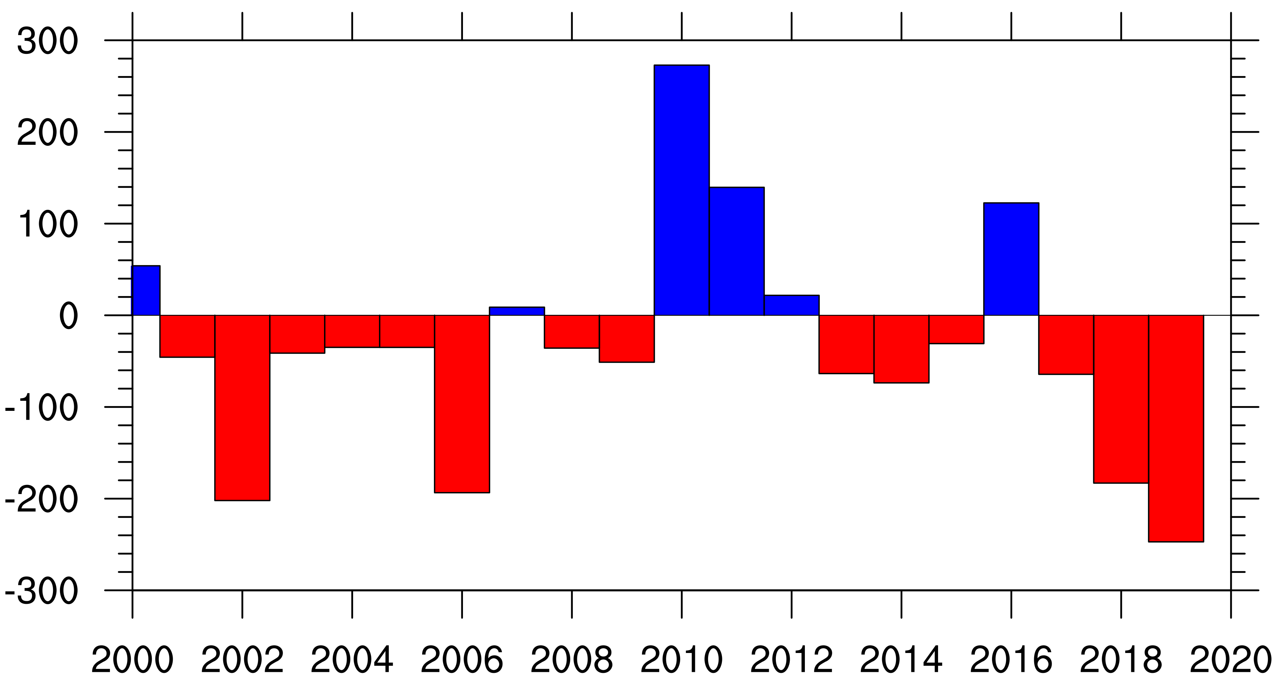
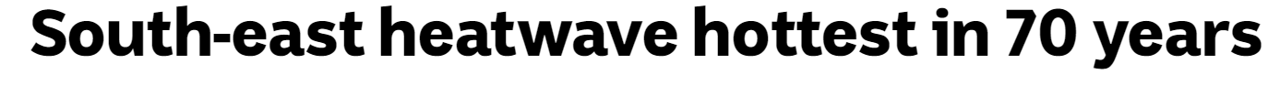
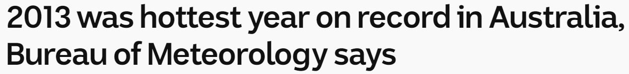
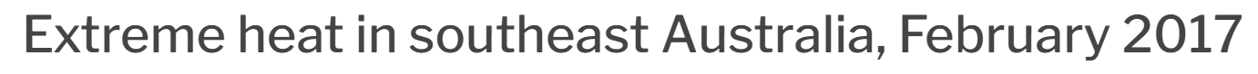
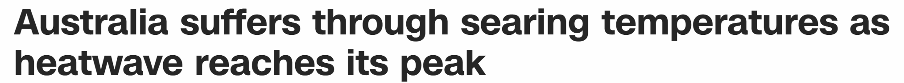
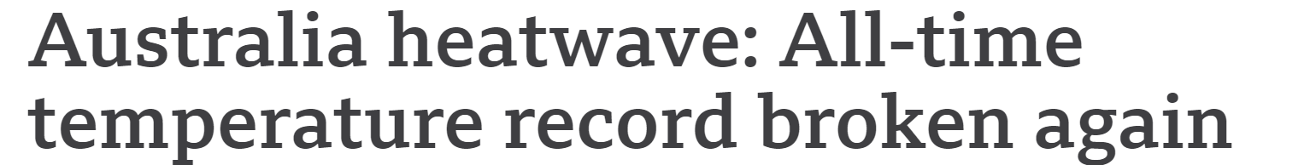
Droughts & heatwaves in SE Australia
Precipitation anomaly (mm yr⁻¹)
Millennium
Drought
Recent
Drought
Trend in total rainfall
(1980-2020)
2001-2009
2017-2019
Heatwaves in news
2009
2013
2017
2019.01
2019.12

Slide 5
Two key questions
How does groundwater influence vegetation during droughts?
Can groundwater mitigate the heat stress on vegetation during heatwaves?

Slide 6
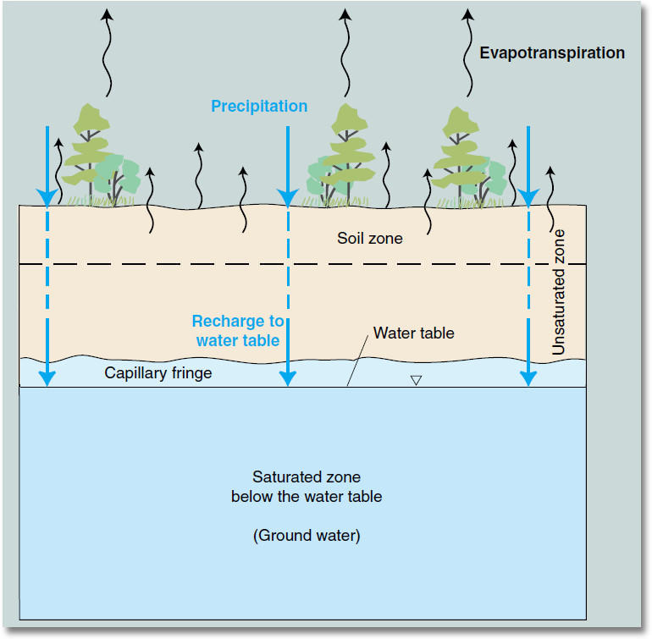
Two key questions
How does groundwater influence vegetation during droughts?
Can groundwater mitigate the heat stress on vegetation during heatwaves?
Free drainage (FD)
Groundwater (GW)
CABLE LSM
Groundwater

Slide 7
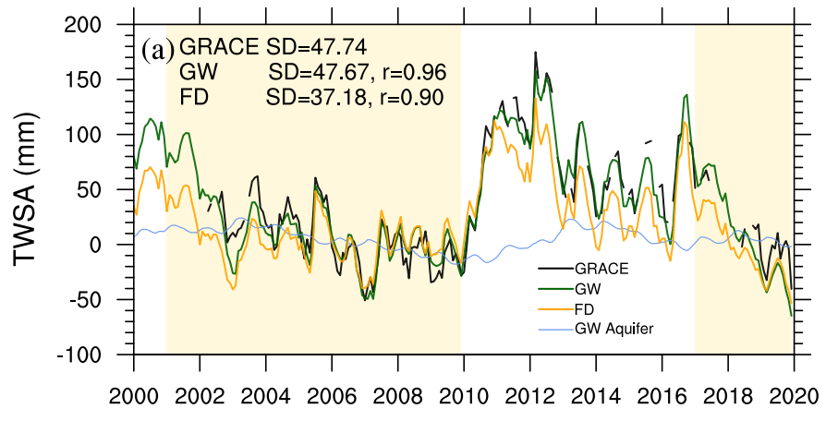
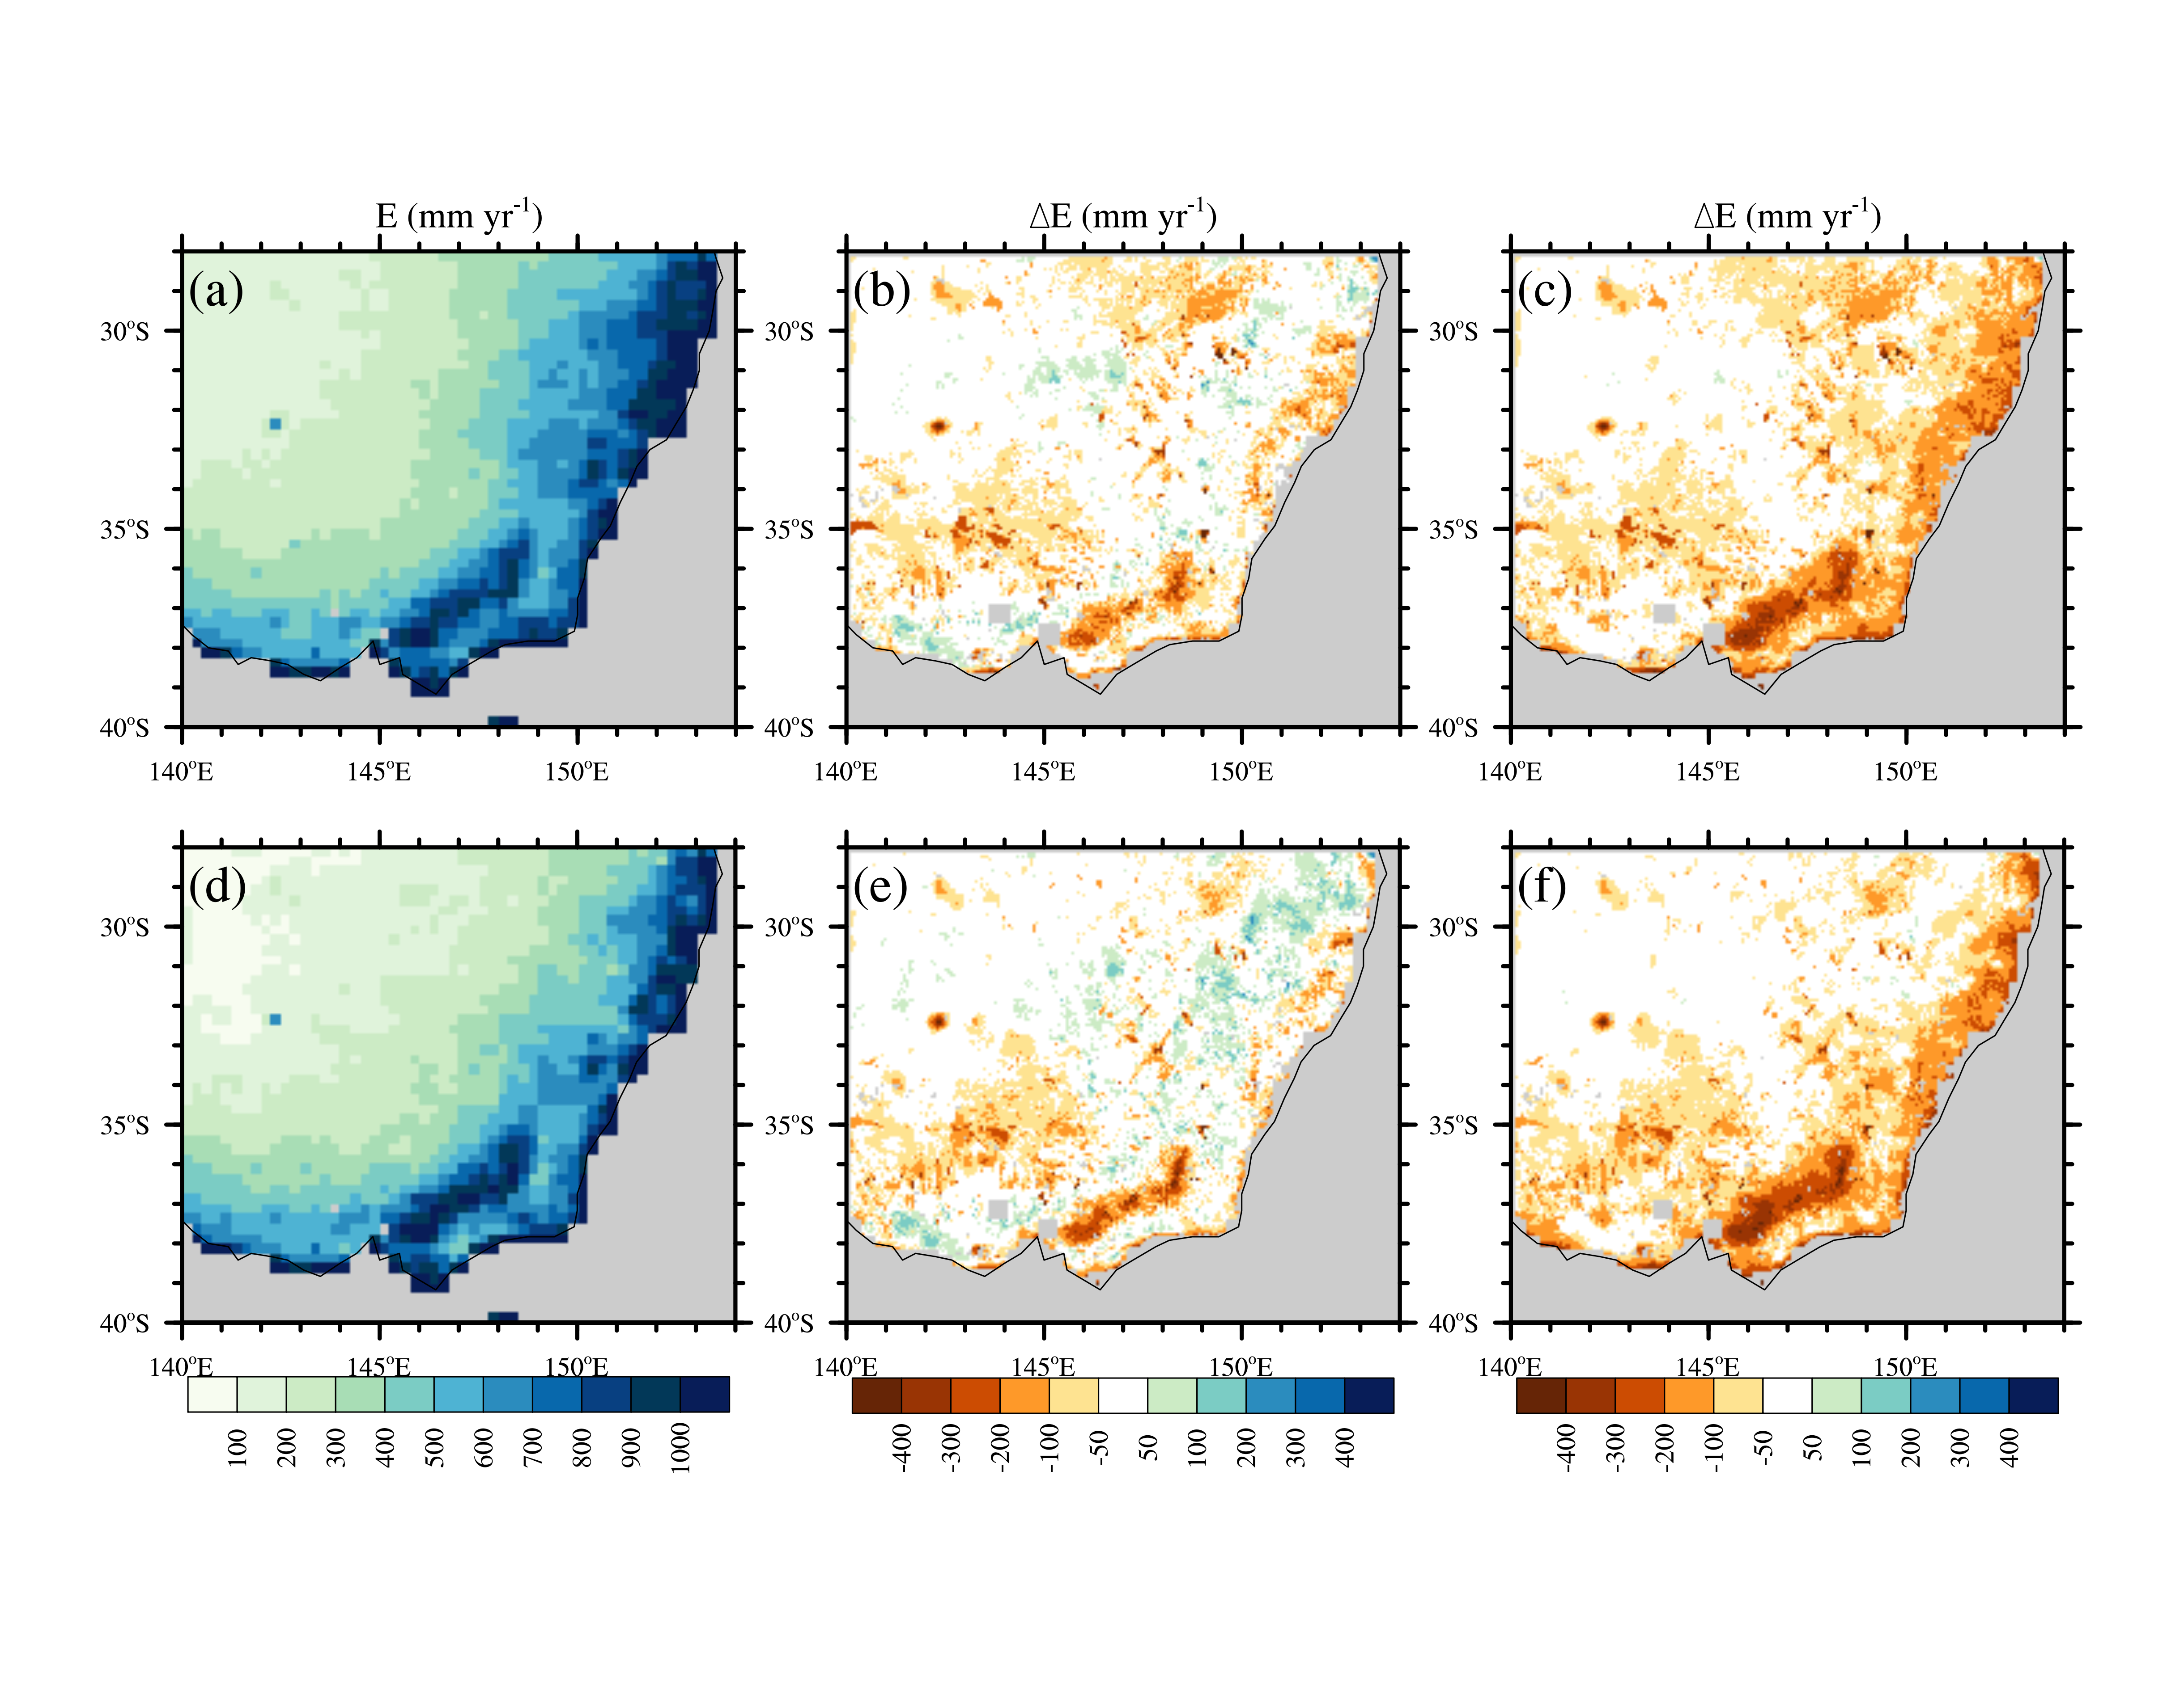
Simulated Millennium Drought & Recent drought
Total water storage anomaly (TWSA)
Both GW and FD can capture the observation well. GW can improve the simulated TWSA.
Black GRACE
Green GW Exp
Orange FD Exp
Annual Evapotranspiration Difference (ΔE)
GW – GLEAM
FD – GLEAM
During
drought
During droughts, GW sustains a higher evapotranspiration (E) and reduces the underestimation of annual E in FD

Slide 8
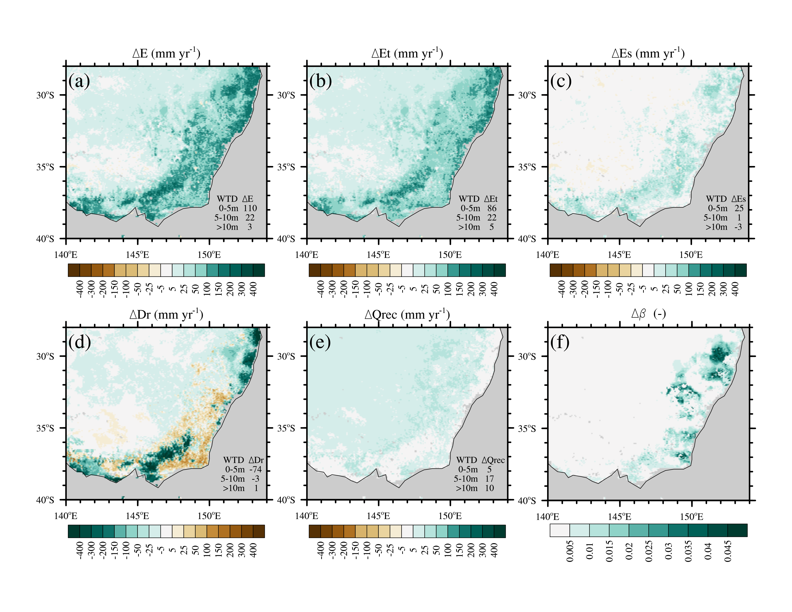
How does GW maintain the higher E during droughts
Groundwater’s impact (GW – FD) during the recent drought
GW sustains a higher E during droughts
The increase in transpiration explains over 78% of the higher evapotranspiration
The higher transpiration is mainly caused by the reduction of vertical drainage which leads to a wetter soil.

Slide 9
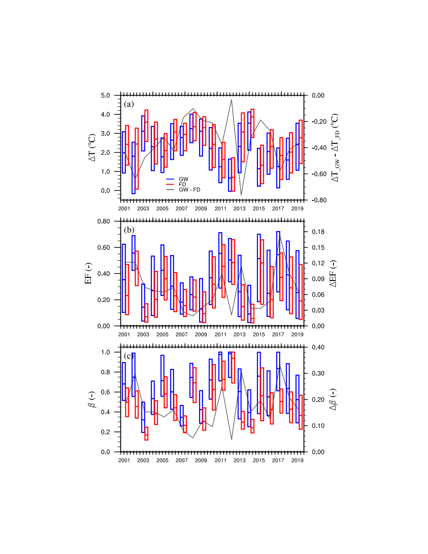
The implication for summer heatwaves
Annual average canopy temperature minus air temperature (ΔT)
GW Exp estimates a lower canopy temperatures. The GW’s mitigation effect on canopy temperature fades as drought extends (see the yellow ovals).
Blue box GW Exp
Red box FD Exp
Gray line GW − FD
Evaporative fraction (EF)
The existence of GW increases 3-18 % of latent heat, reduces sensible heat, and will slow down the heat accumulation in the boundary layer.

Slide 10
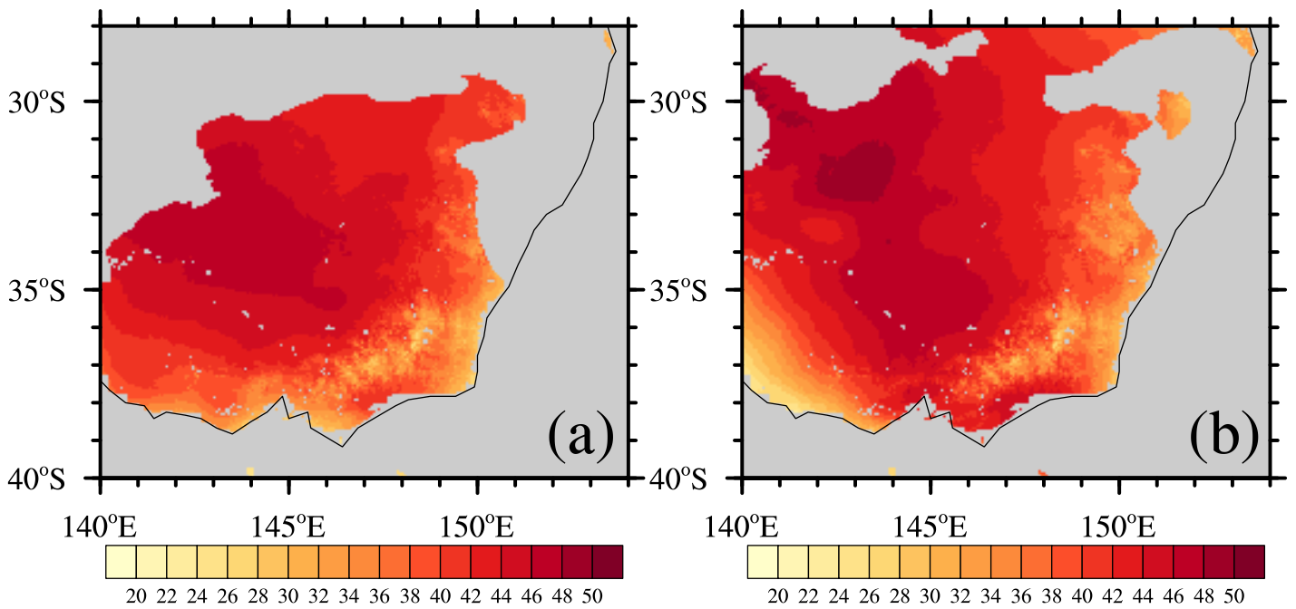
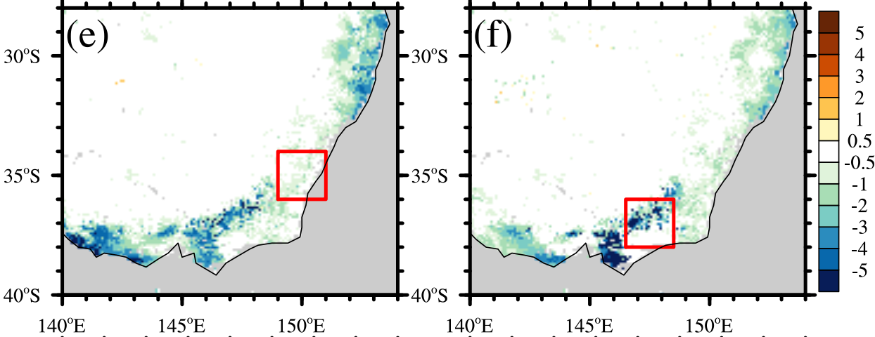
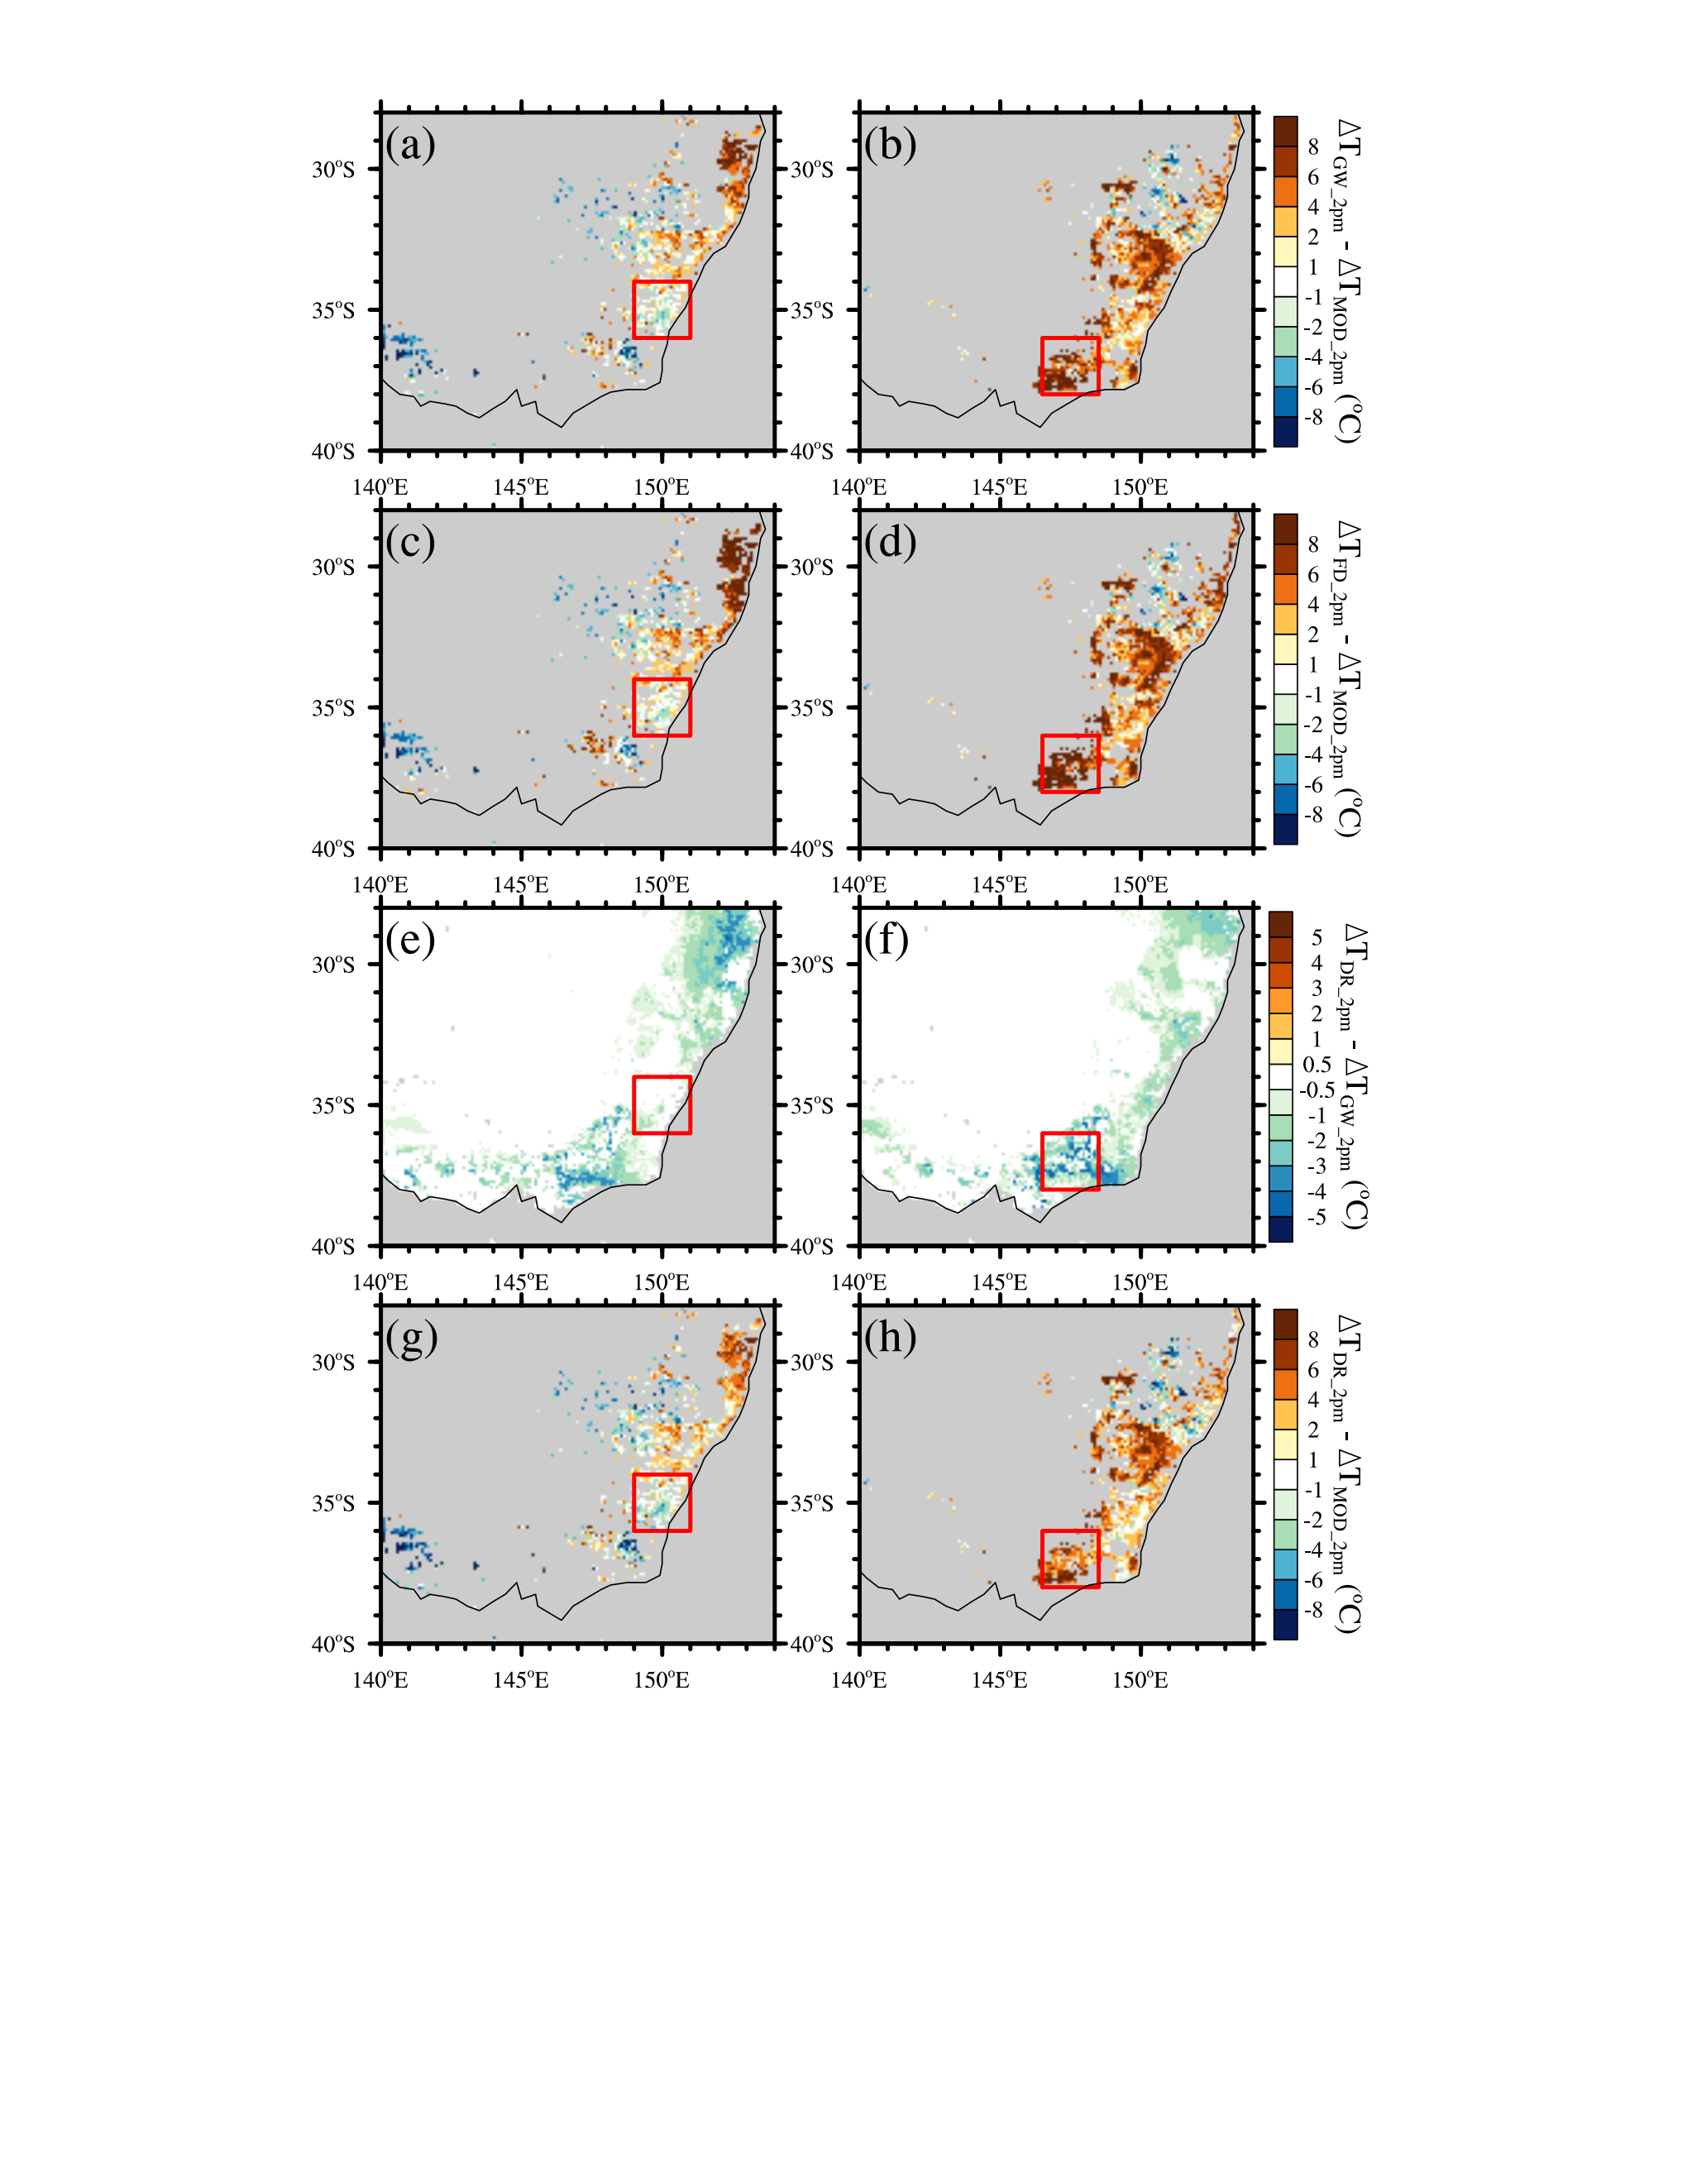
Groundwater’s impact on 2018/2019 compound event
Canopy temperature difference
between GW and FD at 2 pm
T_{max}
T_{max}
GW reduces up to 5°C
15th Jan 2019
25th Jan 2019
15th Jan 2019
25th Jan 2019

Slide 11
Groundwater’s impact on 2018/2019 compound event
Canopy temperature difference
between GW and FD at 2 pm
T_{max}
T_{max}
GW reduces up to 5°C
15th Jan 2019
25th Jan 2019
15th Jan 2019
25th Jan 2019
Deep Root (DR)
Canopy temperature difference
between DR and GW at 2 pm
Deep root impacts plant’s groundwater usage.
Local forests have a deep root system.
DR reduces 1~5°C
Groundwater
15th Jan 2019
25th Jan 2019

Slide 12
Take home message …
Groundwater sustains a higher evapotranspiration mainly by impeding gravity-driven drainage during multi-year droughts.
The extra transpiration enabled by groundwater reduces over 5°C in some coastal regions during heatwaves, but mitigation effect diminishes as the drought lengthens.
The lack of deep roots in CABLE may constrain the groundwater’s mitigation effects.
Next step …
Further study within a coupled model is underway …
More details in
Mu, Mengyuan, Martin G. De Kauwe, Anna M. Ukkola, Andy J. Pitman, Weidong Guo, Sanaa Hobeichi, and Peter R. Briggs. Exploring how groundwater buffers the influence of heatwaves on vegetation function during multi-year droughts. Earth System Dynamics Discussions (2021): 1-29.

